Slide 1

Volume
Techniques

Slide 2
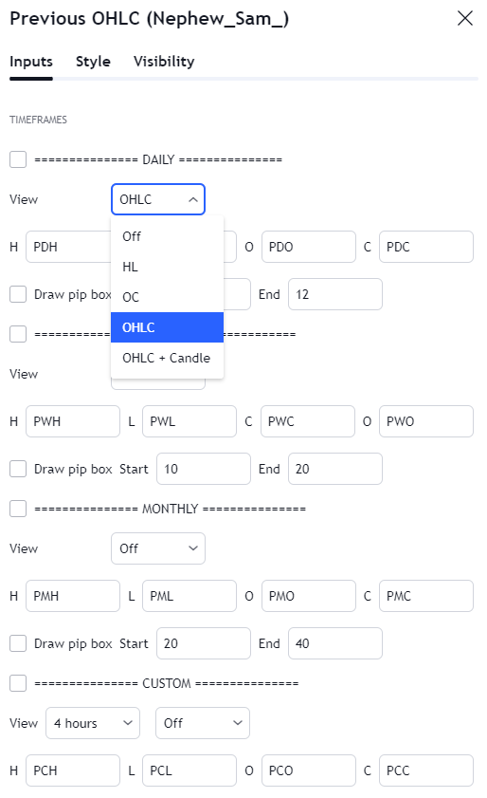
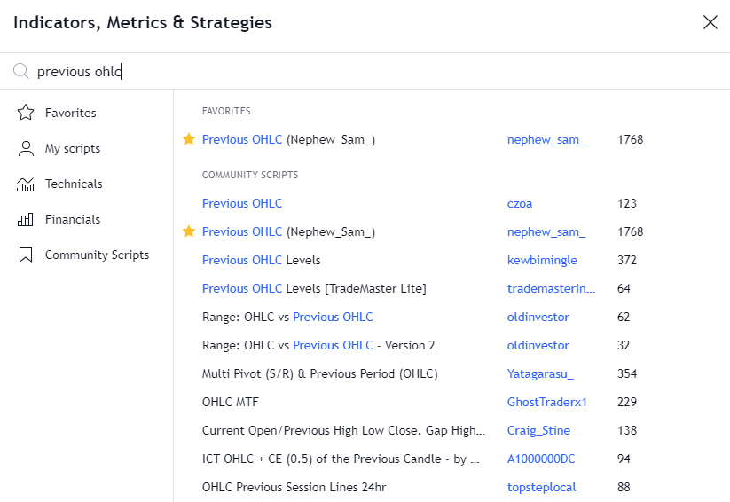
Previous OHLC

Slide 3
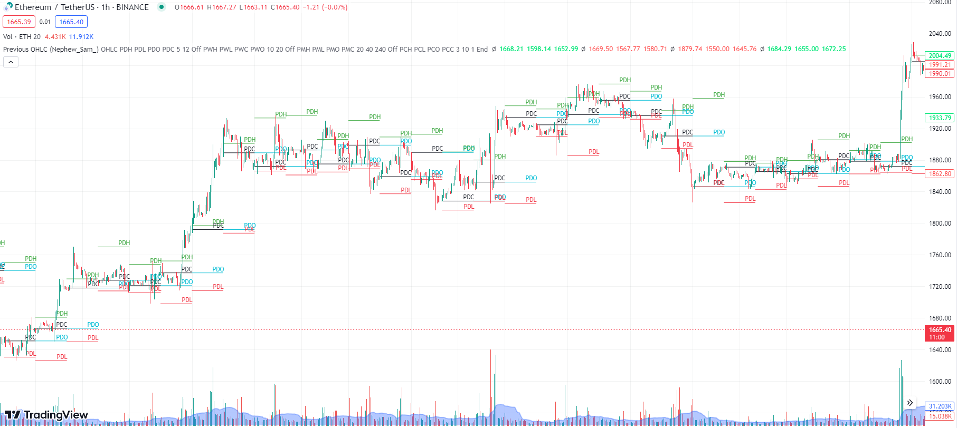
Previous OHLC (UT)
Notes:
1- In UT focus on volume at PDH + PDC
2- Need three consecutive significantly bullish vol bars
3- Volume should be more than previous sessions of the day – Will be marked as demand zone
4- Need Pumping candles (Obvious)

Slide 4
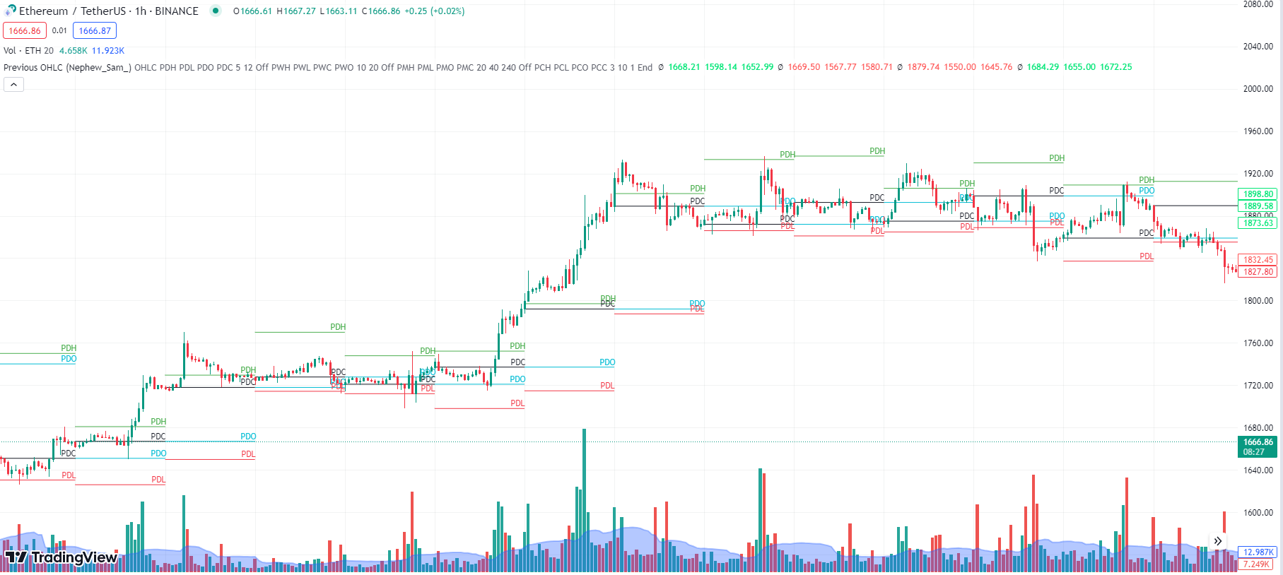
Previous OHLC (UT)

Slide 5
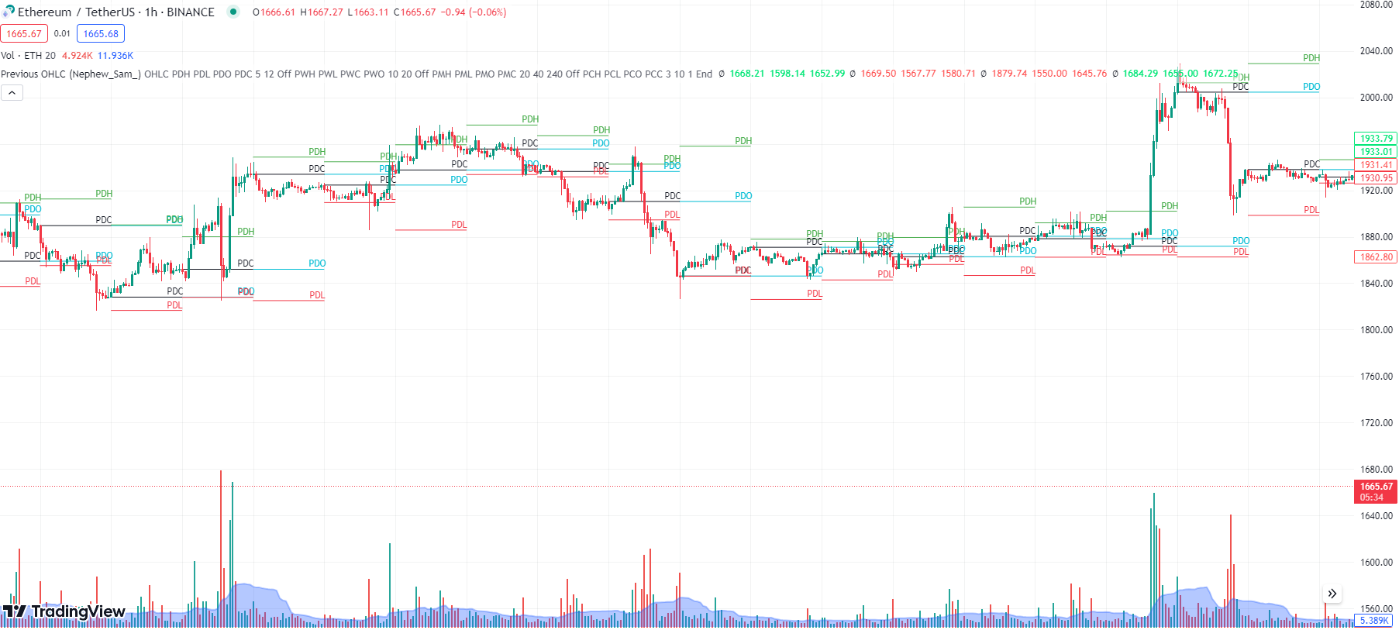
Previous OHLC (UT)

Slide 6
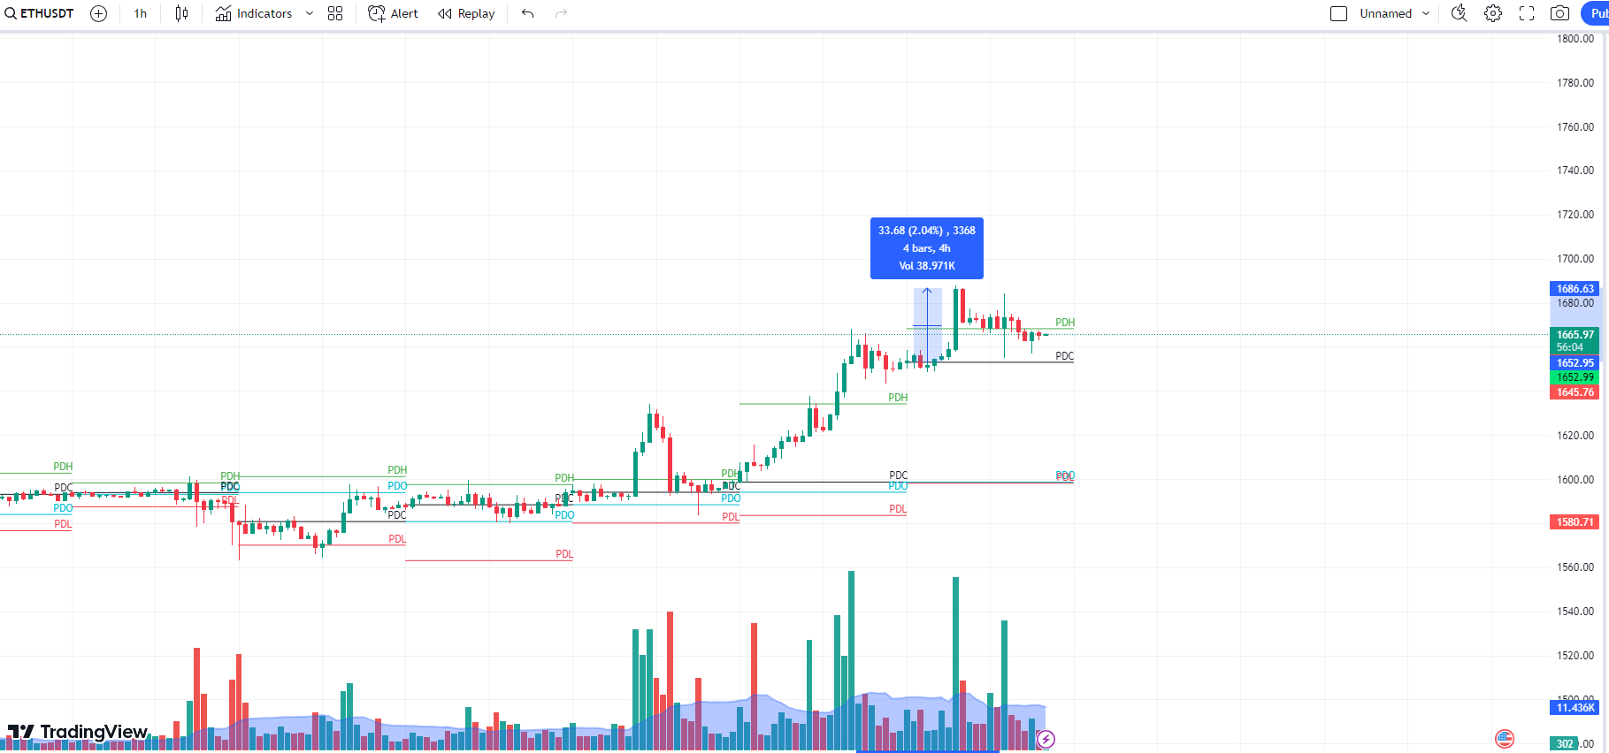
Retail Gains

Slide 7
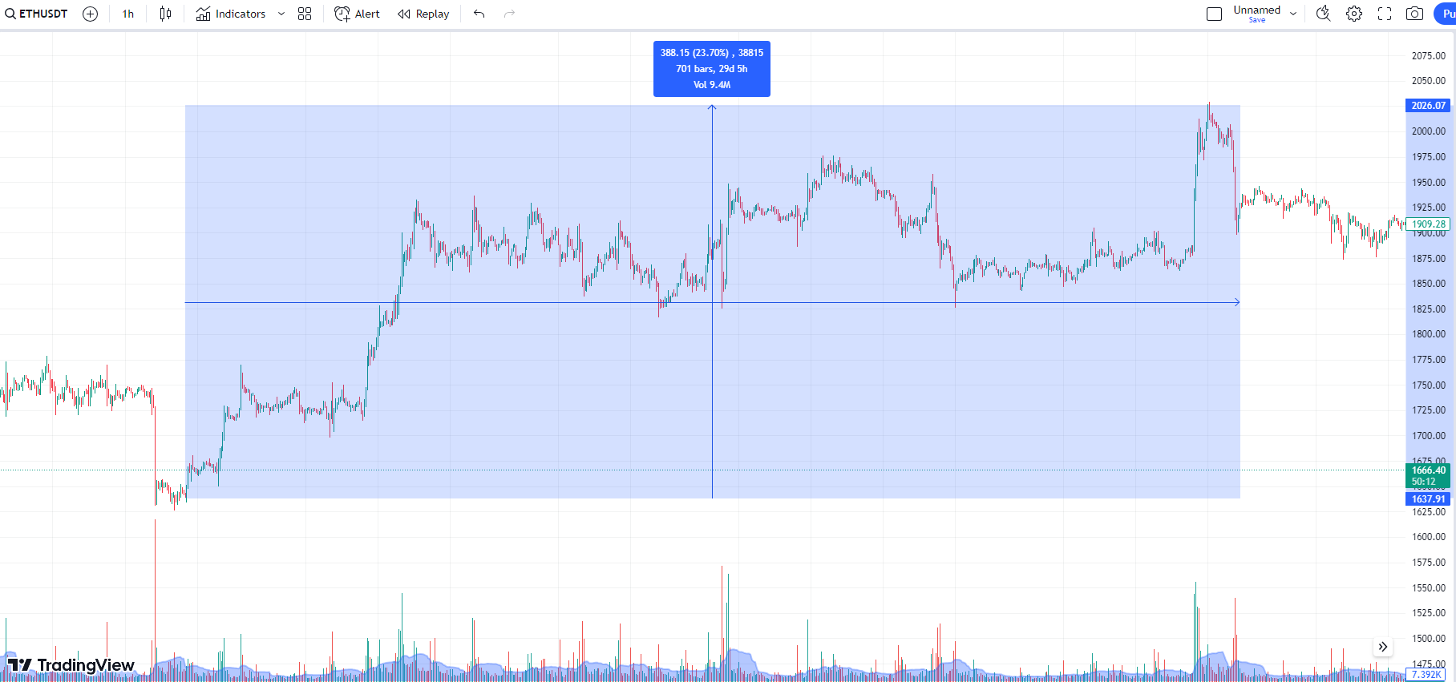
Whale Gains

Slide 8
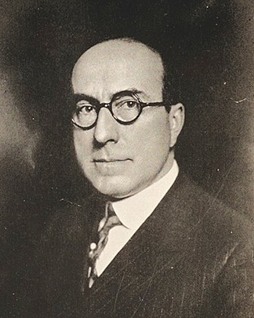
The Wyckoff Method
Richard Wyckoff
Four phases of Price Action
Accumulation
Uptrend
Reaccumulation/Distribution
Downtrend

Slide 9
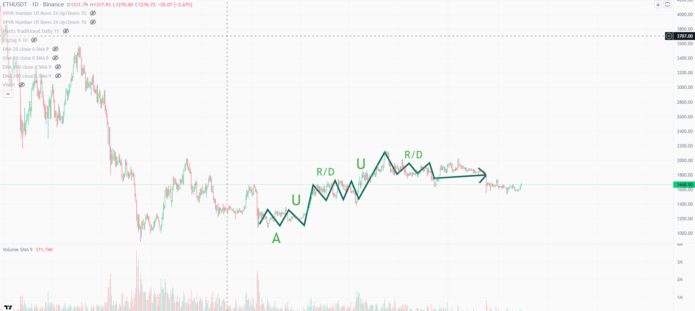
The Wyckoff Method

Slide 10
The Wyckoff Method
Asymmetry of Supply and Demand - Whales vs Retailers
Types of Supply and Demand
Aggressive - Market Orders - Hastens price movement
Aggressive Demand > Passive Supply - Bullish
Aggressive Supply > Passive Demand - Bearish
Passive - Limit Orders - Slows down price movement Absorption: By placing limit orders, one side of market blocks the other.
Determinism - Cause and Effect - Length of Wyckoff Cycle
Notes:
length of accumulation vs length of upcoming trend.

Slide 11
The Wyckoff Method
Anomalies? Yes
In terms of Fast Reversal Patterns
Climax
Double Top/Bottom
Pullback (W/M)
Traps

Slide 12
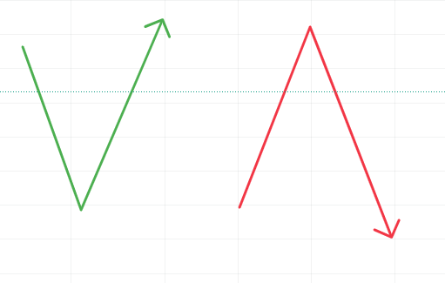
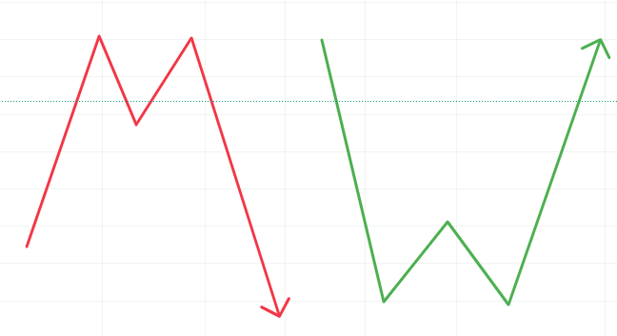
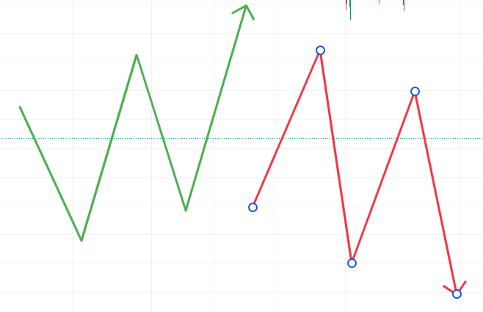
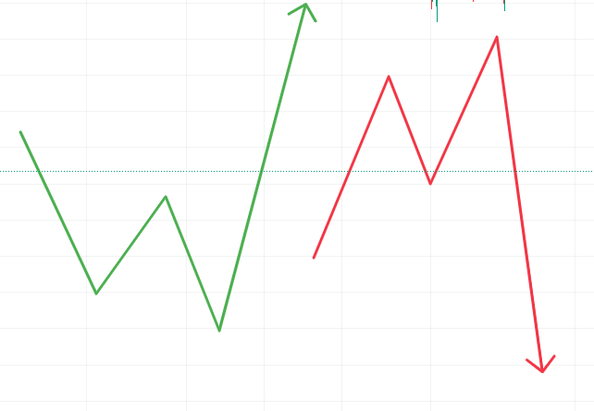
Anomaly Patterns

Slide 13
Harmony and Divergence - VSA
Volume ∝ Price
Harmony - When Price Range corresponds to Volume
Divergence - When Price Range doesn’t reflect the Volume
Notes:
Candle not corresponding to volume - 4 ways - 2 H, 2 D

Slide 14
Harmony and Divergence - SSA
Harmony - High Volume bullish candle should increase the price in the next candle
Divergence - No rise in price in subsequent candles after High Volume candle
Vice Versa
Notes:
Subsequent shift Analysis

Slide 15
Harmony and Divergence - PMA
Harmony : Price movement in the direction of trend (Impulse) should display an increase in Volume, and a decrease in volume in case of a movement opposite (Correction) to trend.
Divergence: In the direction of a trend (Impulse), it should display a decrease in volume and an increase, in the opposite direction of the trend (Correction).
Notes:
Price Movement Analysis

Slide 16
Harmony and Divergence - NAd PMA
Harmony: Volume curve in the next Impulse - Correction Cycle should be more than the previous one.
Divergence: Volume curve reduces it’s as the trend progresses.
Notes:
Non Adjacent Price Movement Analysis

Slide 17
Harmony and Resistance - S/RBA
Harmony: Breakout happens with high volume and the S/R level is not lost afterwards. Survives retesting
Divergence: False Breakout
Well-Informed vs Uninformed
Capital Flow
Notes:
Support and resistance breakout analysis

Slide 18
Accumulation and Distribution in Detail
Reduction in Volume and Volatility
Volume Increases before a breakout
Liquidity Zone - (Spring - Upthrust)
Respective Candlesticks will be wider (WRCs)
Minor HHs and HLs, LHs and LLs
Path of least resistance
Notes:
Reduction in Volume and Volatility
Volume Increases before a breakout
Likely False Breakout (Liquidity Zone) to lure out the uninformed and to sell outside the distribution zone by or in case of accumulation above it
Bearish Candlesticks will be wider
Formation of lower highs and lower lows while in accumulation HHs and HLs
As buying interest is low, a path of least resistance to downside is created

Slide 19
Logical Events
1. Preliminary Stop
2. Climax (SC, BC)
3. Reaction - CHoCH (ARa, ARe)
4. Secondary Test (UA, mSOS, SOW)
5. False Breakout (spring, upthrust)
6. Breakout (sChoCh, SOS, SOW)
7. Confirmation
Notes:
Preliminary Stop - Accumulation → Preliminary Support, Distribution → Preliminary Supply
First entrance of opposite well informed whales
Narrow Range Candles + Constant High Volume , Large shadow and High Volume (Hammer for Accumulation, Inverted Hammer for Distribution)
Possibility of multiple Preliminary Stops - Inertia of trend
Climax- HH before a distribution or LL before an accumulation. Identified by Wide range candle. Before accumulation it is selling climax, before distribution it is buying climax.
Sometimes a trend may not end with climatic volume. If there is a decrease in volume there will be exhaustion (Progressive lower peaks + price and volume become divergent)
Reaction - it is a sharp movement in the opposite direction of the climax. Change of character from trend to side ways, In accumulation reaction is called Automatic Rally. In Distribution reaction is called Automatic Reaction.
In case of accumulation it establishes the upper limit of the range, in case of distribution it sets the lower limit of the range.
It confirms the climax, and establishes context for secondary test.
Secondary test - Test climax with lower volume and NRCs.
In Accumulation - After ST price does some Upthrust Action (UA). before reentering the sideways channel shows a minor sign of strength (mSOS). Then shows SOW at lower limit.
Accumulation False Breakout is called Spring. In Distribution, it is called Upthrust.
Here the Well Informed induce the uninformed to the wrong side of the market to create liquidity zone.
Can be termed as second change of character. In Accumulation it is called Sign of strength (SOS) or Jump Across a Creek (JAC). In Distribution sign of weakness (SOW) or Fall through the Ice (FTI).
Last point of support (LPS) in accumulation or Last point of supply (LPSY).

Slide 20
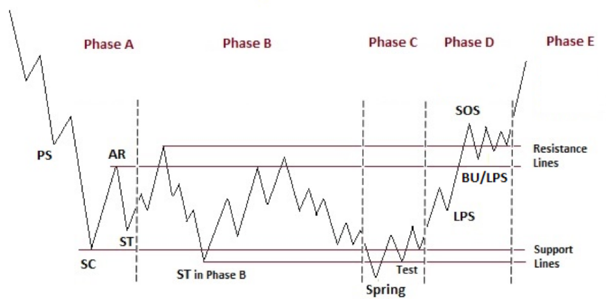
Accumulation Events

Slide 21
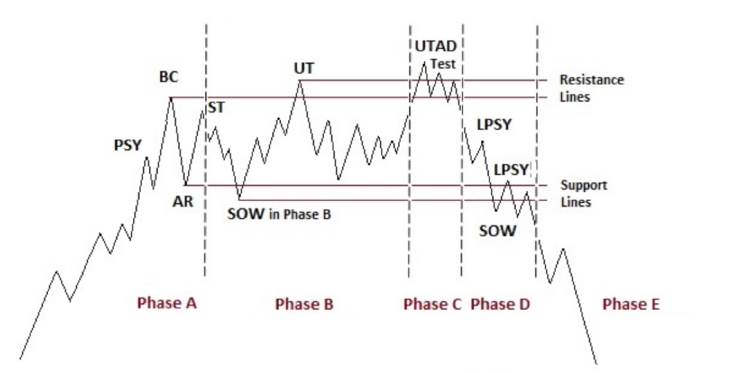
Distribution Events

